Slide 1
Artificial Neural Network (CS642)
Lecture 03 - Dataset for Image Classification
Dr. Abdul Basit
Associate Professor - CSIT University of Balochistan
October 24, 2025
Lec 03 - Dataset for Image Classification

Slide 2
Reference
Most of the material in this lecture are reprinted from the book “ Deep Learning for Computer Vision with Python” by “Dr. Adrian Rosebrock.’
Lec 03 - Dataset for Image Classification

Slide 3
Datasets
Before we dive into any code looking at actually how to take a dataset and build an image classifier, let’s first review datasets that you’ll see inside Deep Learning for Computer Vision.
Some of these datasets are essentially solved, enabling us to obtain extremely high-accuracy classifiers (¿ 95% accuracy) with little effort.
A few of the datasets are part of image classification competitions and challenges (e.x., Kaggle Dogs vs. Cats and cs231n Tiny ImageNet 200).
Lec 03 - Dataset for Image Classification

Slide 4

1 Datasets for image classification MNIST
CIFAR-10 SMILES
Contents
Lec 03 - Dataset for Image Classification
4 / 12

Slide 5
1 Datasets for image classification MNIST
CIFAR-10 SMILES
Contents
Lec 03 - Dataset for Image Classification
4 / 12

Slide 6
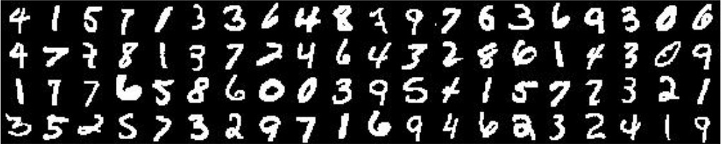
MNIST
The MNIST (“NIST” stands for National Institute of Standards and Technology while the “M” stands for modified as the data has been preprocessed to focus solely on the task of digit recognition.
dataset is one of the most well studied datasets in the computer vision and machine learning literature.
This datasets is a benchmark.
Figure: The goal of this dataset is to correctly classify the handwritten digits, 0 –
9. Source: Adrain Book.
Lec 03 - Dataset for Image Classification

Slide 7
MNIST
MNIST itself consists of 60,000 training images and 10,000 testing images. Each feature vector is 784-dim, corresponding to the 28 × 28 grayscale pixel intensities of the image. These grayscale pixel intensities are unsigned integers, falling into the range [0, 255].
All digits are placed on a black background with the foreground being white and shades of gray. Given these raw pixel intensities, our goal is to train a neural network to correctly classify the digits.
Lec 03 - Dataset for Image Classification

Slide 8
Dataset
Animals: Dogs, Cats, and Pandas
The purpose of this dataset is to correctly classify an image as contain a dog, cat, or panda. Containing only 3,000 images, the Animals dataset is meant to be another introductory dataset that we can quickly train a deep learning model on either our CPU or GPU and obtain reasonable accuracy.
Images for this dataset were gathered by sampling the Kaggle Dogs vs. Cats images along with the ImageNet dataset for panda examples.
Lec 03 - Dataset for Image Classification

Slide 9
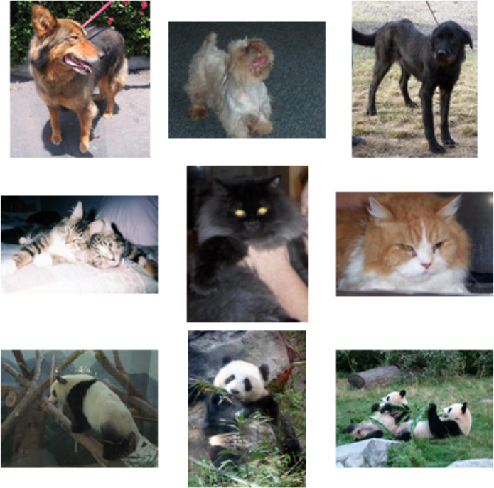
Dataset
Animals: Dogs, Cats, and Pandas
Figure: A sample of the 3-class animals dataset consisting of 1,000 images per dog, cat, and panda class respectively for a total of 3,000 images. Source: Adrain Book.
Lec 03 - Dataset for Image Classification
8 / 12

Slide 10
1 Datasets for image classification MNIST
CIFAR-10 SMILES
Contents
Lec 03 - Dataset for Image Classification
8 / 12

Slide 11
Dataset
CIFAR-10
Just like MNIST, CIFAR-10 is considered another standard benchmark dataset for image classification in the computer vision and machine learning literature.
CIFAR-10 consists of 60,000 32 × 32 × 3 (RGB) images resulting in a feature vector dimensionality of 3072.
As the name suggests, CIFAR-10 consists of 10 classes, including: airplanes, automobiles, birds, cats, deer, dogs, frogs, horses, ships, and trucks.
Compared to ≥ 97% classification accuracy on MNIST, it’s substantially harder obtain such a model for CIFAR-10 and it’s bigger brother, CIFAR-100
Lec 03 - Dataset for Image Classification

Slide 12
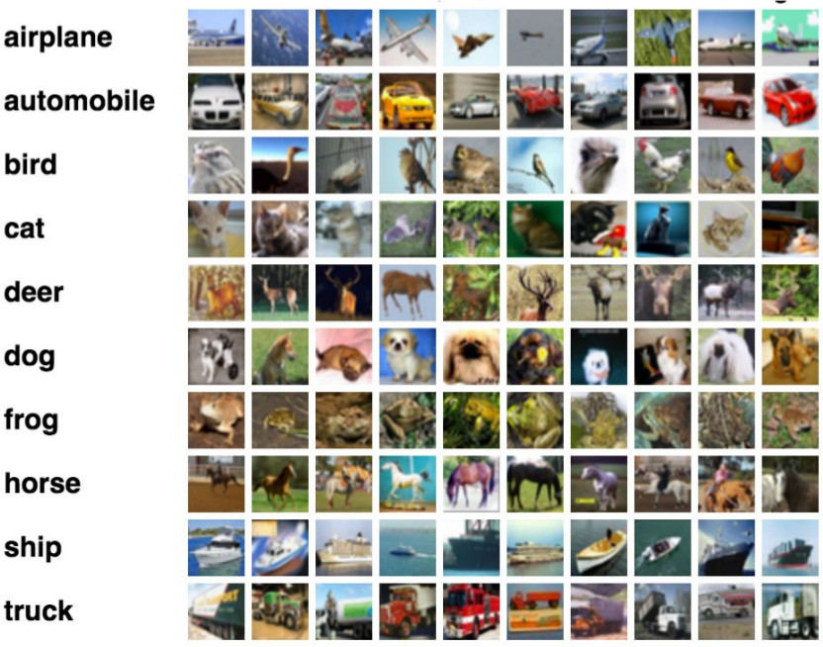
Dataset
CIFAR-10
Figure: Example images from the ten class CIFAR-10 dataset
Lec 03 - Dataset for Image Classification

Slide 13
Dataset
CIFAR-10
The challenge comes from the dramatic variance in how objects appear. For example, we can no longer assume that an image containing a green pixel at a given (x, y)-coordinate is a frog. This pixel could be part of the background of a forest that contains a deer. Or, the pixel could simply be the color of a green truck.
Lec 03 - Dataset for Image Classification
11 / 12

Slide 14
1 Datasets for image classification MNIST
CIFAR-10 SMILES
Contents
Lec 03 - Dataset for Image Classification
11 / 12

Slide 15
Dataset
SMILES
Consists of images of faces that are either smiling or not smiling. In total, there are 13,165 grayscale images in the dataset, with each image having a size of 64 × 64.
Images in this dataset are tightly cropped around the face allowing us to devise machine learning algorithms that focus solely on the task of smile recognition.
Lec 03 - Dataset for Image Classification

Slide 16
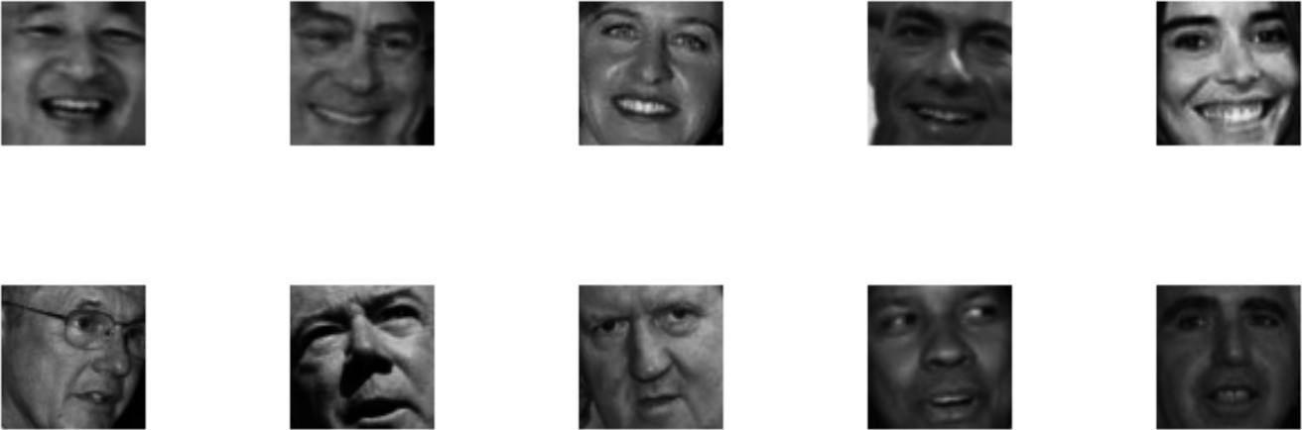
Dataset
SMILES
Figure: Top: Examples of ”smiling” faces. Bottom: Samples of ”not smiling” faces. We will later train a Convolutional Neural Network to recognize between smiling and not smiling faces in real-time video streams. Source: Adrian Book.
Lec 03 - Dataset for Image Classification

Slide 17
Dataset
SMILES
Decoupling computer vision preprocessing from machine learning (especially for benchmark datasets) is a common trend you’ll see when reviewing popular benchmark datasets
In some cases, it’s unfair to assume that a machine learning researcher has enough exposure to computer vision to properly preprocess a dataset of images prior to applying their own machine learning algorithms.
Lec 03 - Dataset for Image Classification
14 / 12

Slide 18
1 Datasets for image classification MNIST
CIFAR-10 SMILES
Contents
Lec 03 - Dataset for Image Classification
14 / 12

Slide 19
Dataset
Kaggle: Dogs vs. Cats
The Dogs vs. Cats challenge is part of a Kaggle competition to devise a learning algorithm that can correctly classify an image as containing a dog or a cat.
A total of 25,000 images are provided to train your algorithm with varying image resolutions.
Lec 03 - Dataset for Image Classification

Slide 20
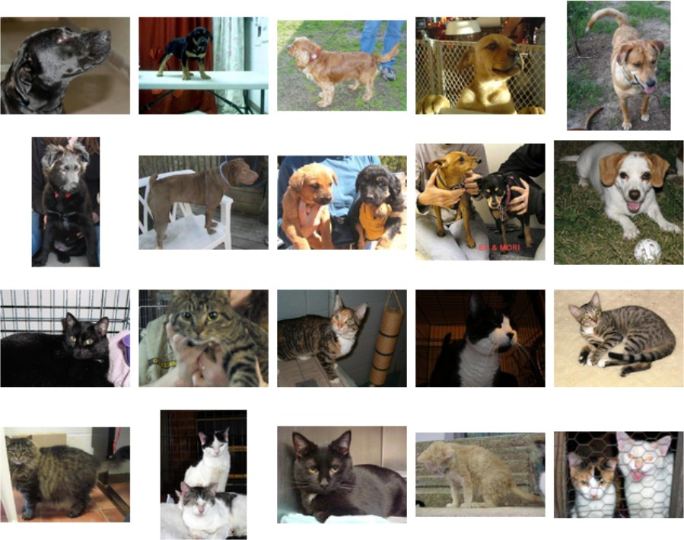
Dataset
Kaggle: Dogs vs. Cats
Figure: The goal of this 2-class challenge is to correctly identify a given input image as containing a ”dog” or ”cat”. Source: Adrian Book.
Lec 03 - Dataset for Image Classification
16 / 12

Slide 21
1 Datasets for image classification MNIST
CIFAR-10 SMILES
Contents
Lec 03 - Dataset for Image Classification
16 / 12

Slide 22
Dataset
Flowers-17
The Flowers-17 dataset is a 17 category dataset with 80 images per class curated by Nilsback et al. [52]. The goal of this dataset is to correctly predict the species of flower for a given input image. A sample of the Flowers-17 dataset
Flowers-17 can be considered a challenging dataset due to the dramatic changes in scale, view- point angles, background clutter, varying lighting conditions, and intra-class variation.
As a general rule of thumb, it’s advisable to have 1,000-5,000 example images per class when training a deep neural network
Lec 03 - Dataset for Image Classification

Slide 23
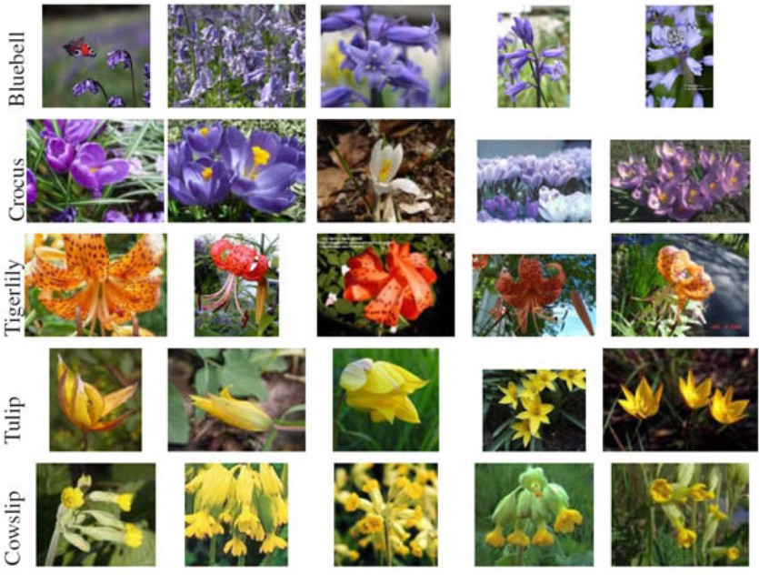
Dataset
Flowers-17
Figure: A sample of five (out of the seventeen total) classes in the Flowers-17 dataset where each class represents a specific flower species. Source: Adrian Book.
Lec 03 - Dataset for Image Classification
18 / 12

Slide 24
1 Datasets for image classification MNIST
CIFAR-10 SMILES
Contents
Lec 03 - Dataset for Image Classification
18 / 12

Slide 25
Dataset
CALTECH-101
the CALTECH-101 dataset is a popular benchmark dataset for object detection. Typically used for object detection (i.e., predicting the (x, y)-coordinates of the bounding box for a particular object in an image), we can use CALTECH-101 to study deep learning algorithms as well.
The dataset of 8,677 images includes 101 categories spanning a diverse range of objects, including elephants, bicycles, soccer balls, and even human brains, just to name a few.
Lec 03 - Dataset for Image Classification

Slide 26
Dataset
Tiny ImageNet 200
image classification challenge for students similar to the ImageNet challenge, but smaller in scope.
There are a total of 200 image classes in this dataset with 500 images for training, 50 images for validation, and 50 images for testing per class. Each image has been preprocessed and cropped to 64 × 64 × 3 pixels making it easier for students to focus on deep learning techniques rather than computer vision preprocessing functions.
Lec 03 - Dataset for Image Classification
20 / 12

Slide 27
1 Datasets for image classification MNIST
CIFAR-10 SMILES
Contents
Lec 03 - Dataset for Image Classification
20 / 12

Slide 28
Dataset
Adience
The Adience dataset, Constructed in 2014, is used to facilitate the study of age and gender recognition. A total of 26,580 images are included in the dataset with ages ranging from 0-60. The goal of this dataset is to correctly predict both the age and gender of the subject in the image.
Lec 03 - Dataset for Image Classification
21 / 12

Slide 29
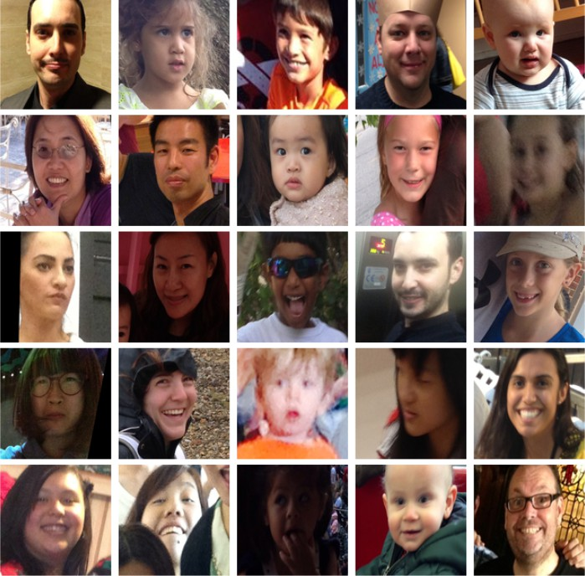
Dataset
Adience
Figure: A sample
of the Adience dataset for age and ge
n
recognition. Ageder
Lec 03 - Dataset for Image Classification
22 / 12

Slide 30
1 Datasets for image classification MNIST
CIFAR-10 SMILES
Contents
Lec 03 - Dataset for Image Classification

Slide 31
Dataset
Adience
ImageNet is actually a project aimed at labeling and categorizing images into almost 22,000 categories based on a defined set of words and phrases.
there are over 14 million images in the ImageNet project.
ImageNet follows the WordNet hierarchy [59]. Each meaningful word/phrase inside WordNet is called a “synonym set” or “synset” for short.
Within the ImageNet project, images are organized according to these synsets, with the goal being to have 1,000+ images per synset
Lec 03 - Dataset for Image Classification
23 / 12

Slide 32
1 Datasets for image classification MNIST
CIFAR-10 SMILES
Contents
Lec 03 - Dataset for Image Classification
23 / 12

Slide 33
Dataset
Adience
ImageNet is actually a project aimed at labeling and categorizing images into almost 22,000 categories based on a defined set of words and phrases.
1
Angry
Disgust (sometimes grouped in with “Fear” due to class imbalance) Fear
Happy
Sad Surprise
2
3
4
5
6
Lec 03 - Dataset for Image Classification
24 / 12

Slide 34
The End
34 / 15

